Slide 1





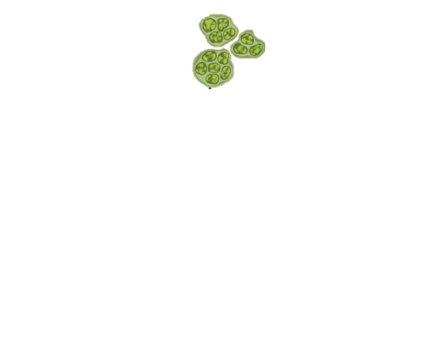
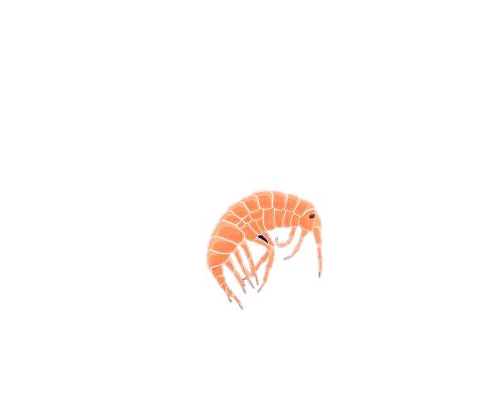
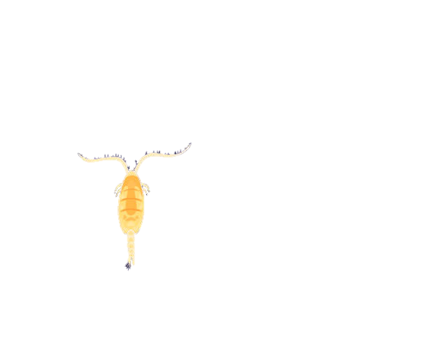

CO₂
Phytoplankton
(fix CO₂ into organic carbon)
Euphotic zone
(sunlit)
Zooplankton (microbial predators)
Carbon Export
Bacteria
(recycle organic carbon)
Mesopelagic zone
(twilight)
Decaying organic matter

